Slide 1

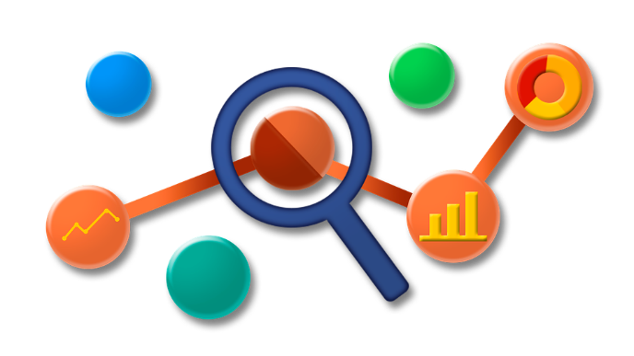


Instrumentation of Java Application using OTel, Tempo & Data Dog

Slide 2
Agenda!
Observability basics
Challenges with observability back-ends
Why OpenTelemetry?
How Open Telemetry Works?
Demo!

Slide 3
Observability Basics
Why Observability?
Are logs sufficient for gaining observability?

Slide 4



Three pillars of Observability
Logs
A log is time stamped message emitted by a service, server or other components.
Ex:
I, [2021-02-23T13:26:23.505892 #22473] INFO -- : [6459ffe1-ea53-4044-aaa3-bf902868f730] Started GET "/" for ::1 at 2021-02-23 13:26:23 -0800
Metrics
Aggregations over a period of time of numeric data about your infrastructure or application.
Ex: system error rate, CPU utilization, request rate for a given service
Traces
Records the paths taken by requests (made by an application or end-user) as they propagate through multi-service architectures, like micro services.
The context of what and why things are happening and the story of the communication between services.

Slide 5
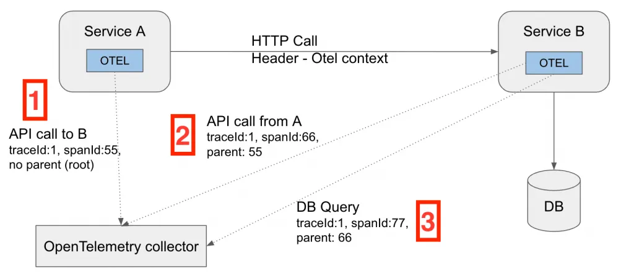
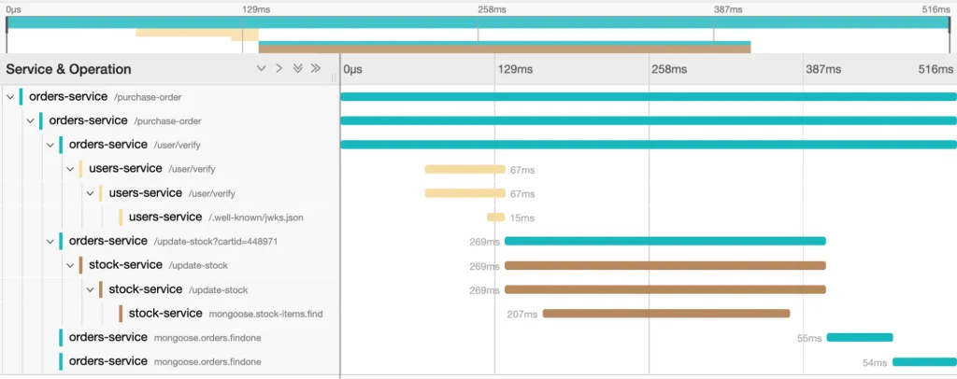
Anatomy of a distributed trace
Each trace consists of spans. Span tracks specific operations that a request makes, painting a picture of what happened during the time in which that operation was executed
A trace tell us how long each request took, which components and services it interacted with, and the latency introduced during each step, giving you a complete picture, end-to-end.
Trace Workflow
Sample Trace

Slide 6
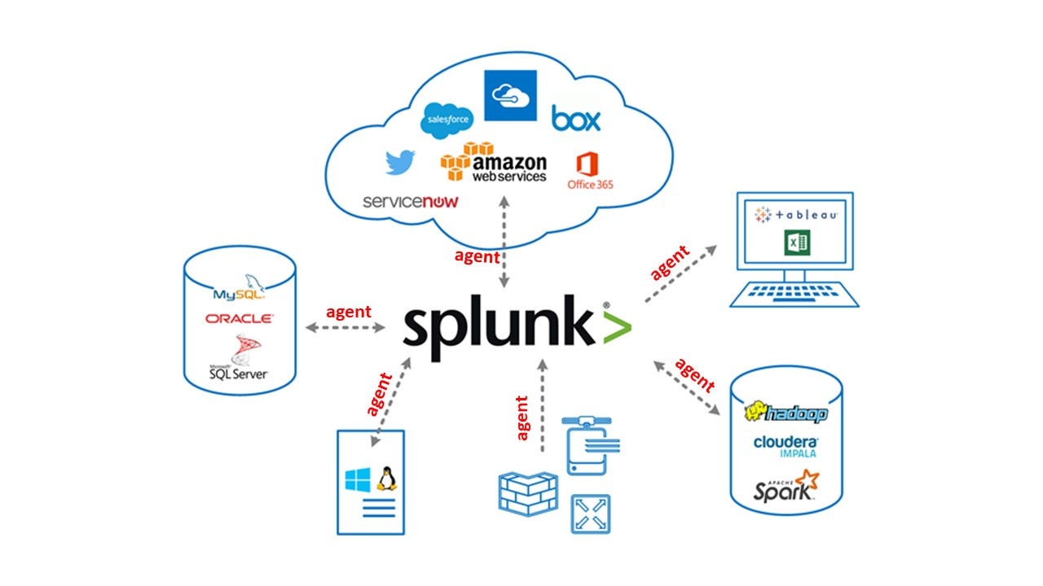
Typical Observability Workflow
Each observability back-end needs its own instrumentation libraries and agents to be installed for emitting data to the tools.
Splunk, Dynatrace, Data Dog, etc are some of the popular observability back-ends.
In the scenario(ref image), splunk agent is installed on all the resources to collect and send telemetry data to Splunk enterprise backend.

Slide 7

Challenges with observability back-ends
Need for multiple observability tools for collecting logs, traces, and metrics.
Different vendor specific instrumentation like install their specific agents, etc
Whenever a new observability tool is purchased,
Need to instrument across hundreds of micro services.
Migrate data pipelines from existing observability systems to new one.
Compare and validate data between old and new systems.

Slide 8
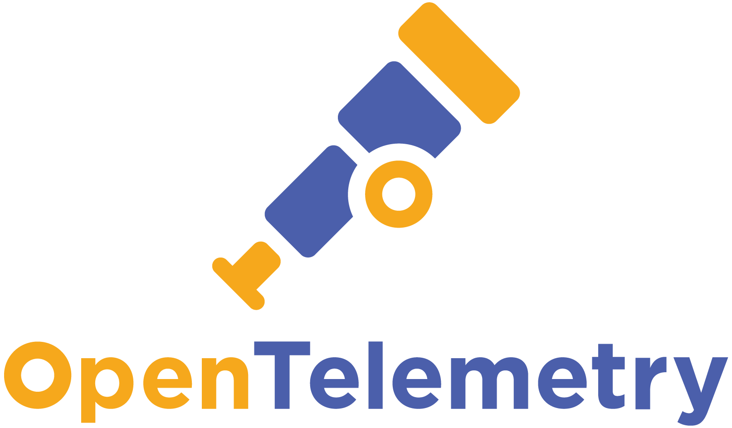
Why OpenTelemetry(OTel)?
A single, vendor-agnostic observability instrumentation that can send telemetry to observability back end.
An end-to-end implementation to generate, emit, collect, process, and export telemetry data.
Full control of your data with the ability to send data to multiple destinations in parallel through configuration.
Second most active CNCF project behind Kuberenetes.
A path forward no matter where you're on your observability journey.

Slide 9
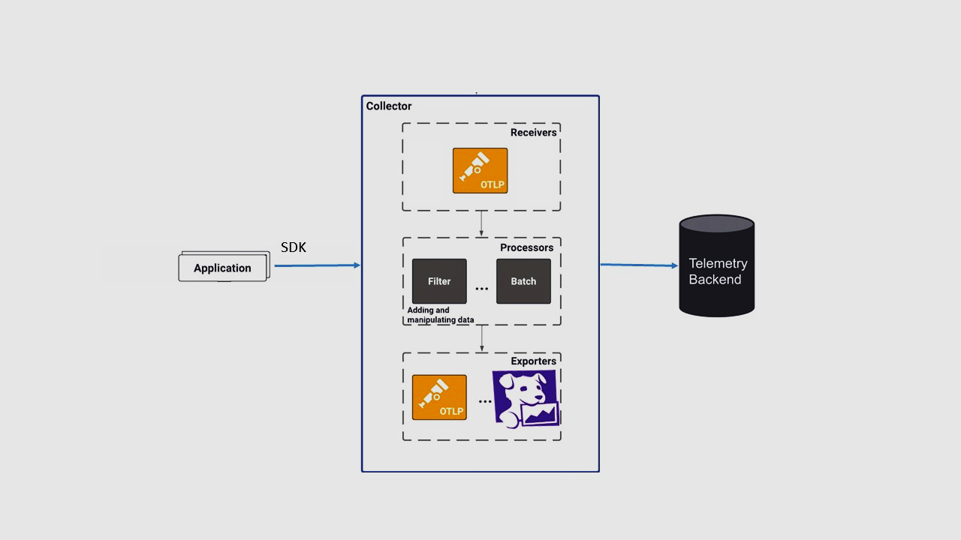
How Otel Works?
Open Telemetry provides each language a single API and a single SDK(an open telemetry client Library) with which you can manually instrument your application to generate metrics and tracing telemetry.
OTLP uses, 4317 default port
OpenTelemetry Collector is built as a processing pipeline in a pluggable architecture, with three configurable part written in yaml.
Receivers for ingesting incoming data of various formats and protocols, such as OTLP, Jaeger and Zipkin.
Processors for performing data aggregation, filtering, sampling and other collector processing logic on the telemetry data. Processors can be chained to produce complex processing logic.
Exporters for emitting the telemetry data to one or more backend destinations (typically analysis tools or higher order aggregators) in various formats and protocols, such as OTLP, Prometheus and Jaeger.
pipeline
OTel Collector

Slide 10




Demo with Automatic Instrumentation!
Run
App (Java JAR)
+
OTel Java Agent
Otel Collector Container
Lis
Otel Collector
Receiver
(OTLP)
App emits Telemetry on host port 5555 as specified in the java agent configuration
Listening on port 5555
Processor
(batch)
Helper Shell Script
Exporter
(OTLP, Data Dog)
Docker Compose
Saas Offering

Slide 11
Demo Contd…
Pre-Requisites:
GIT
Docker and Docker Compose
Java 17 or +
Maven 3.8.6 or +
References:
GIT Repo of the code - https://github.com/srinibasu/java_otel_tempo_datadog_demo.git
Note: make sure you’re using master branch.
Open Telemetry Documentation: https://opentelemetry.io/docs/what-is-opentelemetry/
OTel Automatic Instrumentation of Java App - https://opentelemetry.io/docs/instrumentation/java/automatic/
OpenTelemetry Datadog Exporter: https://docs.datadoghq.com/opentelemetry/otel_collector_datadog_exporter/?tab=onahost
Lab Documentation Reference: https://www.buildon.aws/tutorials/instrumenting-java-apps-using-opentelemetry
Otel Tutorial: https://www.youtube.com/watch?v=XvmicNH_4lc&list=PLDqi6CuDzubz5viRapQ049TjJMOCCu9MJ&index=2

Slide 12
So, what’re the key takeaways?
How Otel decouples observability back-ends from applications.
How to gain easy data or telemetry portability to your desired tooling without making any configuration changes or any heavy lift of configuring 100s of micro services for new tooling.
How to run java application with Java Otel Agent to emit telemetry data?
How to write a Otel Collector Config file?
How to run your Otel Collector with a docker container using Otel Config file?
How to send data to data dog and Grafana Tempo parellely without installing their respective agents?

Slide 13


